Slide 1
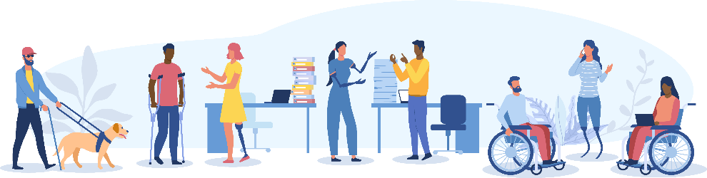
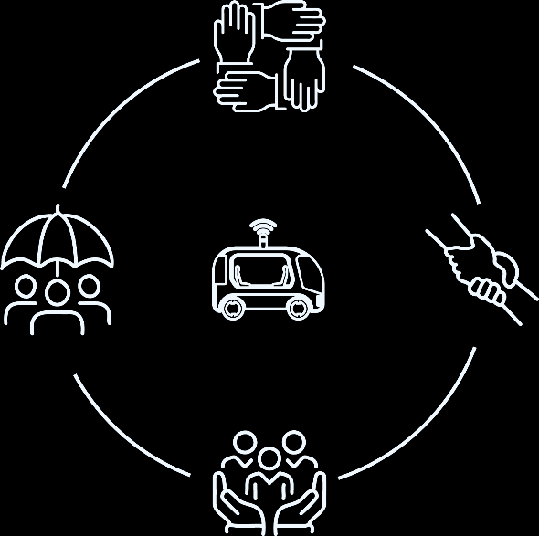



Perceptions of autonomous vehicle among older adults and people with physical disability
2025 TRANSW Symposium
Candidate: Arkar Than Win
Supervisors: Professor John Nelson and Associate Professor Chinh Ho
Discipline: Institute of Transport and Logistics Studies
Date: 24th of November 2025

Slide 2
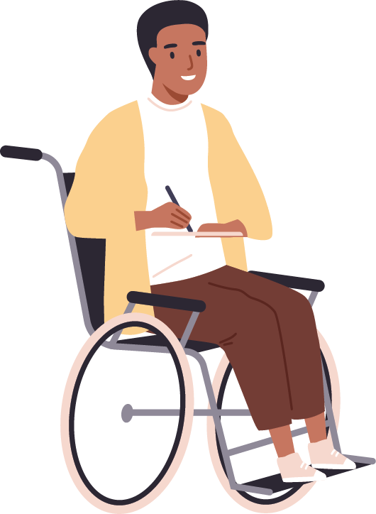
Meet James
A young man who battles physical challenges daily

Slide 3
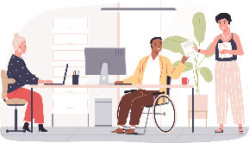
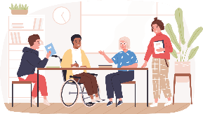
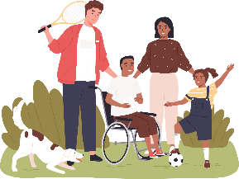

Slide 4
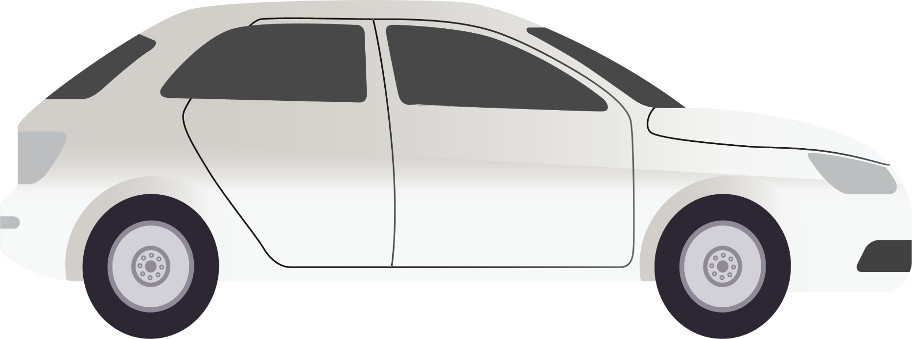
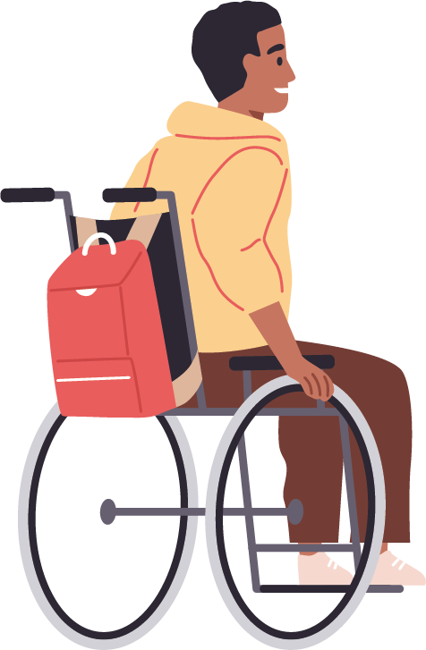

Slide 5

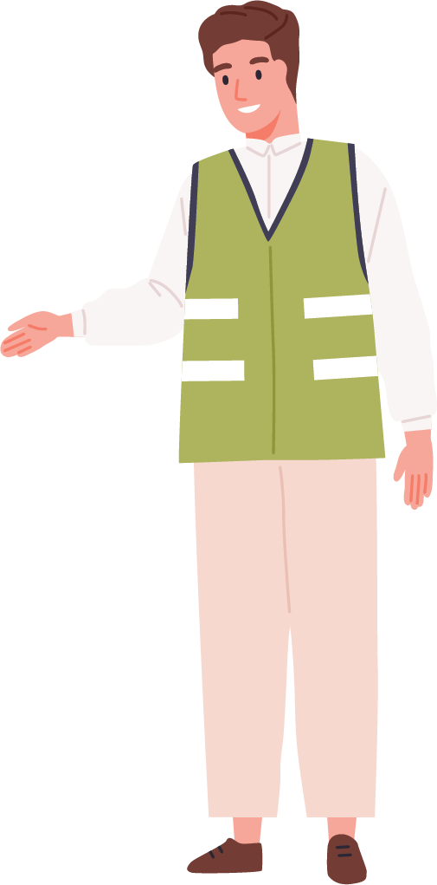
Dependence on Others’ Availability

Slide 6
Dependence on Others’ Availability

Slide 7
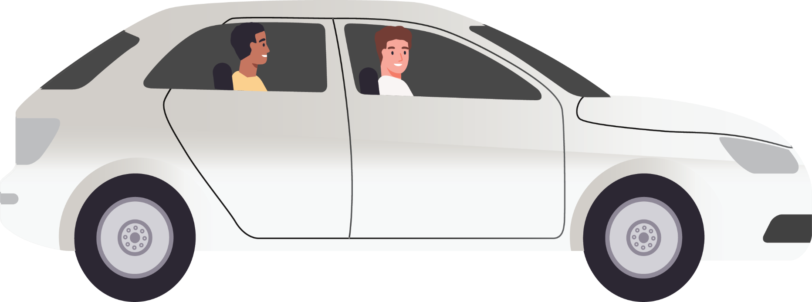
Missed Opportunities

Slide 8
Meet James
A young man who battles physical challenges daily
Missed Opportunities

Slide 9
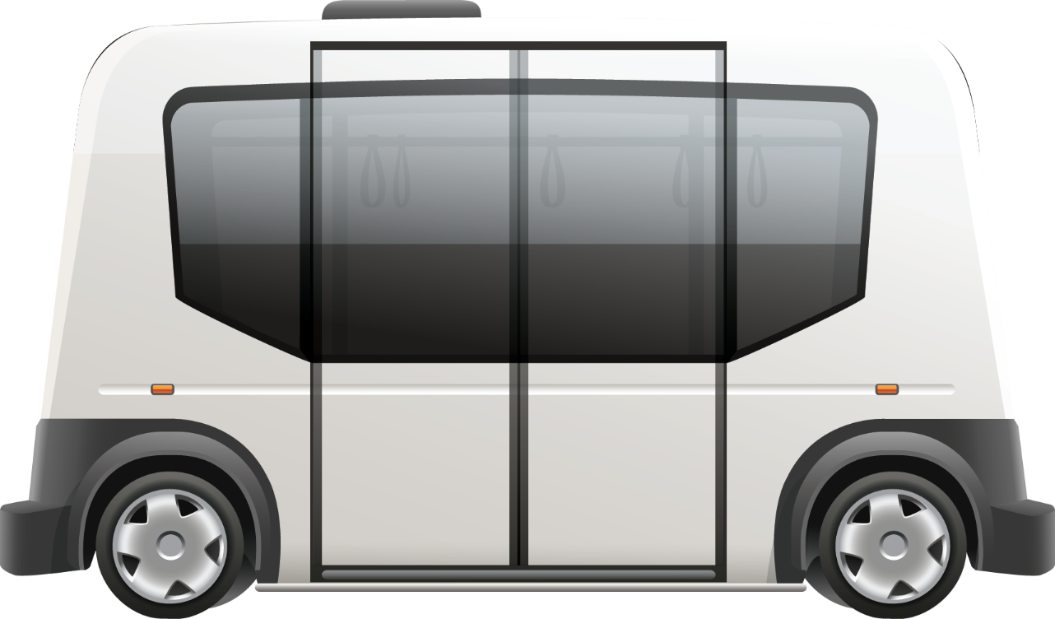
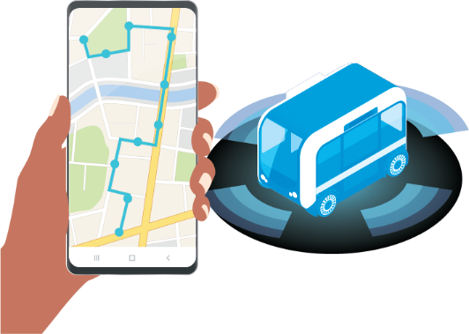
Meet James
A young man who battles physical challenges daily
Independence

Slide 10

Meet James
A young man who battles physical challenges daily

Slide 11

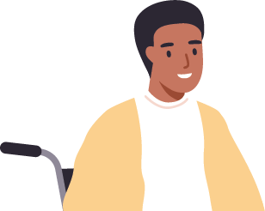


Social
Education
Work

Slide 12
Meet James
A young man who battles physical challenges daily
Social
Education
Work

Slide 13
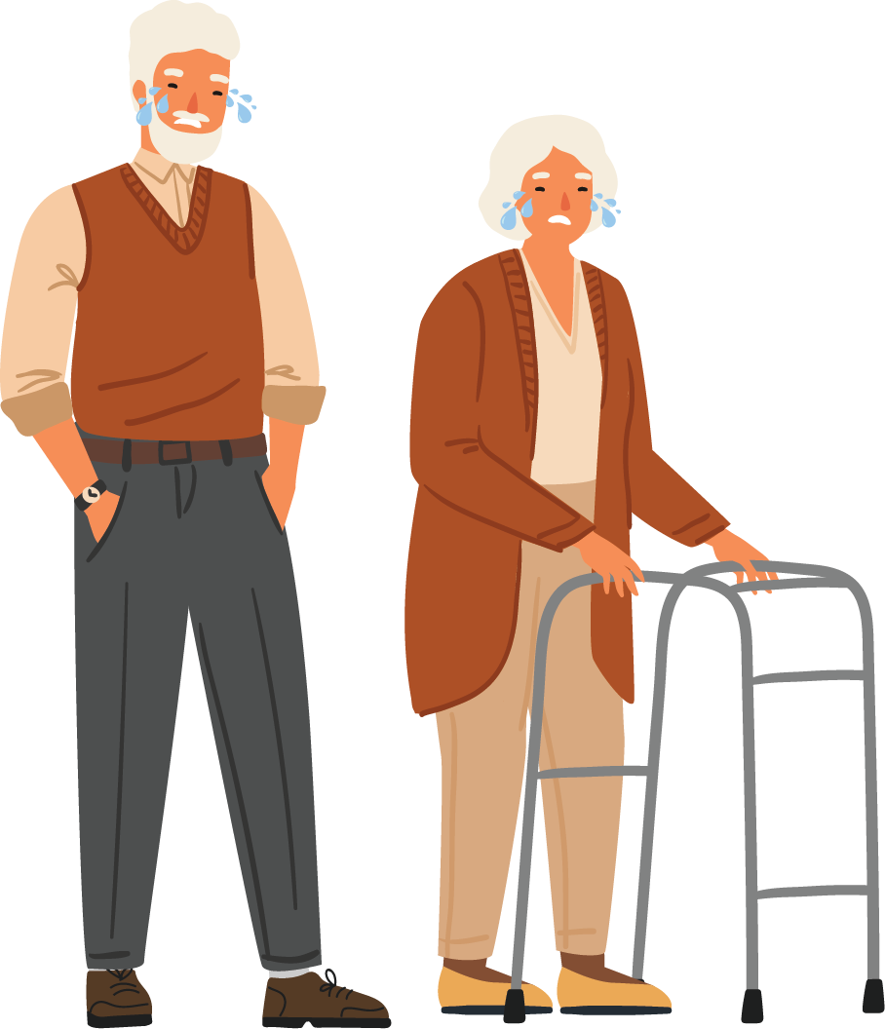

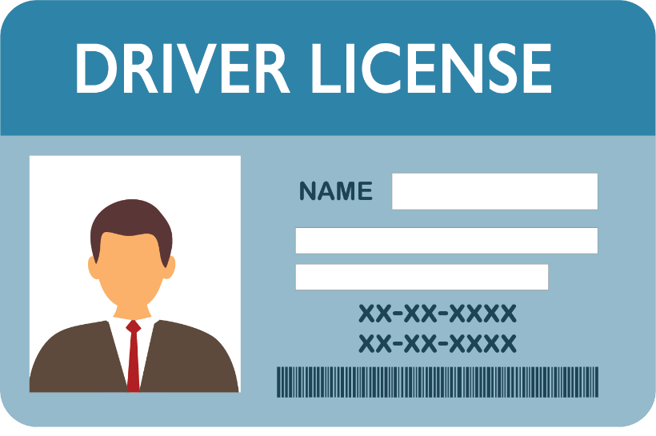

Slide 14
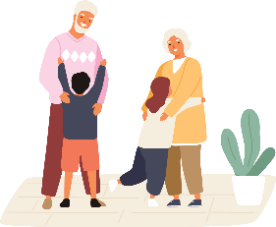
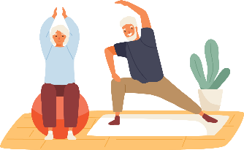
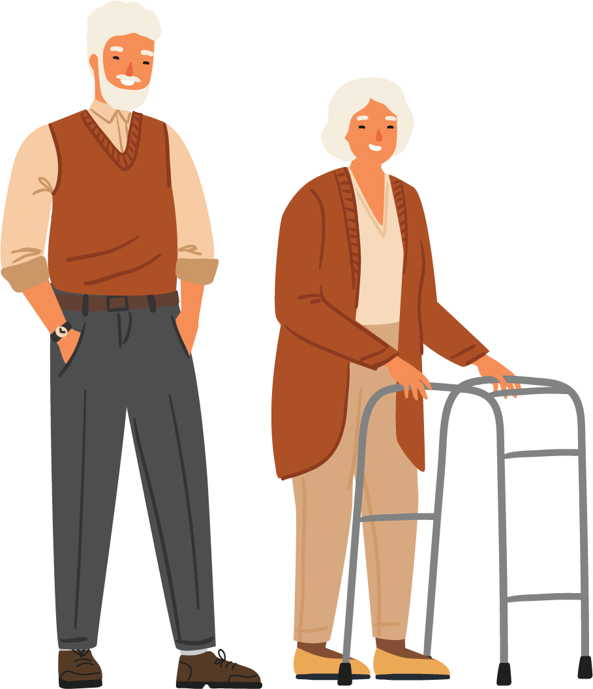


Slide 15




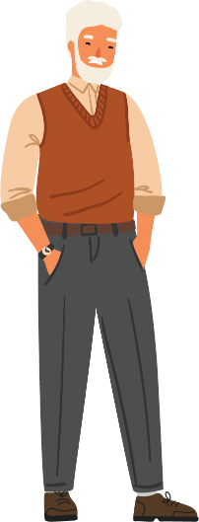
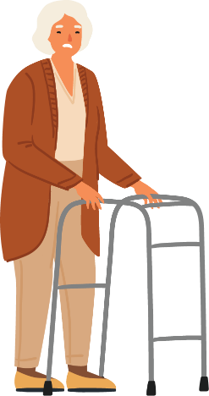
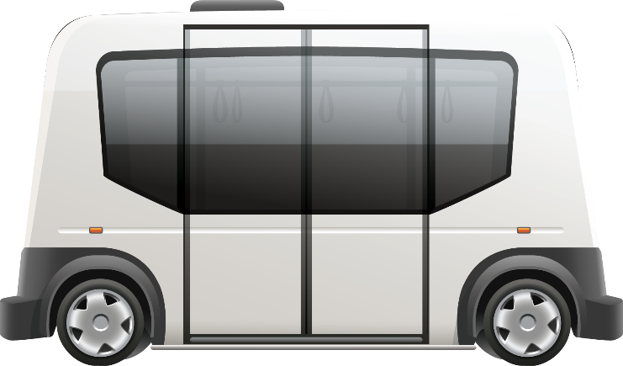

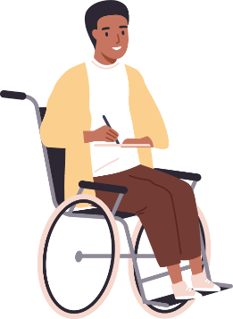

Research Problem
Unrealized Potential !

Slide 16



Research Problem
Technology Acceptance Model (Davis, 1985)
Perceived
usefulness
Why? (Underlying Beliefs)
Attitude toward using
Use
Perceived ease of use
AVs are useful and easy to use
I like travelling with AVs
I will travel with AVs

Slide 17
Methodology
Perceived
usefulness
XXXXXXXXXXXX
YYYYYYYYYYYY
XXXXXXXXXXXX
YYYYYYYYYYYY
X , Y
Aim
To explore the underlying belief shaping perceived usefulness and perceived ease of use of AVs among older adults and people with physical disabilities
Data
Focus groups and in-depth interviews (N = 20)
Analysis
Thematic analysis
Perceived usefulness : the extent to which an individual believes using AVs would enhance or diminish their travel and their ability to participate in activities
Perceived ease of use: the extent to which an individual believes travelling with AVs requires less or more physical and/or mental effort compared to their prior experience.
Perceived ease of use
ZZZZZZZZZZZZZ
AAAAAAAAAAAA
AAAAAAAAAAAA
ZZZZZZZZZZZZZ
Z , A

Slide 18



Findings: Private AVs
Perceived Usefulness
Transport safety (+/-)
Accommodation of limitations (age & disability) (+)
Independent mobility (+)
Vehicle access (+)
Exposure to road rage (+)
Driving enjoyment (-)
Ability to independently perform errands (+)
Opportunities to undertake other activities (+/0)
“Because of the way they truffle off by themselves when you're not using them, it's more likely that people [within household] would share cars. So, I only need it to go out in the mornings and I'm home in the afternoon, but if you want to use it in the afternoon, you can use it. You don't have to worry about them wrecking the car because they're not actually driving it.”
Female, 65 - 74
“I think the younger people tail. They sit behind an older person, and they push them to go faster. You might get a horn that is blown at you from behind because you might be a bit slower. But if a younger person sees a driverless car, they can only target the car, not the person in the car. The driverless car might be able to do this speed and keep both younger and older people happier.”
Female, 65 – 74, Disabled (Physical)
“I think women would love it because they just say, I want to go to the shop, I don’t want my husband there because he will be bored waiting for me… You’ve got a lot of things on, and you’re trying to juggle, you know, kids going to soccer, … sleepover or whatever. It comes to the front door. Put little Johnny there, he goes to the address. You don’t have to go.”
Male, 65 – 74
“I suppose if there might be less accident. It even might be more careful than us.”
Male, 75+
“You can work if you want to, if you are working, but I am not working. So, read, stream your favorite show”
Male, 65 – 74
“I was doing a lot of driving, and then I had a very bad car accident. I have multiple sclerosis and lost all my confidence, and then I handed my driver’s license. My right leg doesn’t work very well. Good for people like us that can’t drive anymore.”
Female, 55 – 64, Disabled (Physical)
“So long as you can get out of your house and get into one. You’ll never have to depend on anyone for the rest of the time you are mobile. Don’t have to call one of the family members and feel bad about it.”
Female, 65 – 74, Disabled (Physical)
“I do like driving now. It’s control. It is probably my thing. It makes you feel good. You are in control of the vehicle.”
Male, 65 – 74
“I wouldn’t put that on an expressway with all the man drivers that we’ve got… Because there was a Tesla … knocked out three cars”
Female, 75+, Disabled (Physical)
“Well, when I’m in someone’s car, I can’t help but always watch a traffic”
Female, 55-64, Disabled (Physical)

Slide 19
Findings: Private AVs
Perceived Ease of Use
Learning (+/-)
Driving & Parking (+)
“Driving is already programmed in, but you have to operate the program. That would be my driving lesson… The driving part would have been decreased like it wouldn’t be there. Road rules and all that around parking, that would be depleted. So, the only thing for me, would be learning the technology.”
Female, 65 - 74, Disabled (Physical)
“Because of my arthritis, I get pains, leg pain, knee pain, that sort of pain when I’m driving for a good couple of hours … We are older. We're slower to respond. We’re distracted easily. I think you wouldn't get as tired, because when you're driving, you're looking, you're concentrating, so it [PAV]) wouldn't get as tired.”
Female, 65 – 74
“It could be quite hard. I sort of struggled to understand the new features on my car or my phone, and I used to be in IT.”
Female, 65 – 74

Slide 20
Findings: Shared AVs & Autonomous Public Transport
“It would give you more time to load and get yourself set up and attach to whatever you need to be. You’re the one who actually direct it. So, you have control in that way, the getting on and getting off”
Female, 65 – 74, Disabled (Physical)
Perceived Usefulness
Transport safety (+/-)
Personal safety (+/-)
Personal security (-)
Health safety (-)
Exposure to travel-related scams (+)
Opportunities for social interaction during travel (-)
“I suppose if there might be less accident. It even might be more careful than us.”
Male, 75+
“How do I know it’s going to be clean? … there is rubbish everywhere and … a needle there. With a taxi, we’ve got the driver… There’s always someone there overlooking”
Female, 55 – 64, Disabled (Physical)
“We still need human. Talking to someone. Get into this car, not talk to anyone in the car because no one there … that sort of interaction that puts you back in the community.”
Female, 55 – 64, Disabled (Physical)
“I would imagine you just ask it [SAVs] to be taken to place like taxi, and they take you. May be not like some taxi that take you the longest way round and charged you twice as much”
Female, 75+, Disabled (Physical)
“If I was in a car with somebody I didn’t know, with no one else, I don’t think I’d like that. I think I’d feel a bit vulnerable”
Female, 65 – 74
“If you’re getting on with walker and use that ramp to get up, it’s nice to know that there’s somebody watching you and assisting you if necessary, … that incline can be enough to make it very difficult for some people on walkers, and it might be a case of losing your balance … , or I don’t think that’s going to save you, whereas having the driver there.”
Female, 75+, Disabled (Physical)
“I wouldn’t put that on an expressway with all the man drivers that we’ve got… Because there was a Tesla … knocked out three cars”
Female, 75+, Disabled (Physical)

Slide 21
Findings: Shared AVs & Autonomous Public Transport
Perceived Ease of Use
Accessing travel information (-)
Boarding, seating, and alighting (-)
Learning (-)
“I think they’d be better on the bus. We definitely need help to get on and off, especially if shopping. When I travelled by public transport, the drivers were just so accommodating. I got on these huge buses, and he made sure that I was in the right spot and told this girl to get up, she’s got to sit there. Sometimes I need someone in authority that is in charge.”
Female, 55-64, Disabled (Physical)
“Some people wouldn’t like that, because they like to ask the driver questions, like, is this where I wait to come back again? Or so what’s the next bus? Or even, I want to get to the hospital, is this the best stop? So, you’d lose that source of information.”
Female, 65 – 74
“It could be quite hard. I sort of struggled to understand the new features on my car or my phone, and I used to be in IT.”
Female, 65 – 74

Slide 22
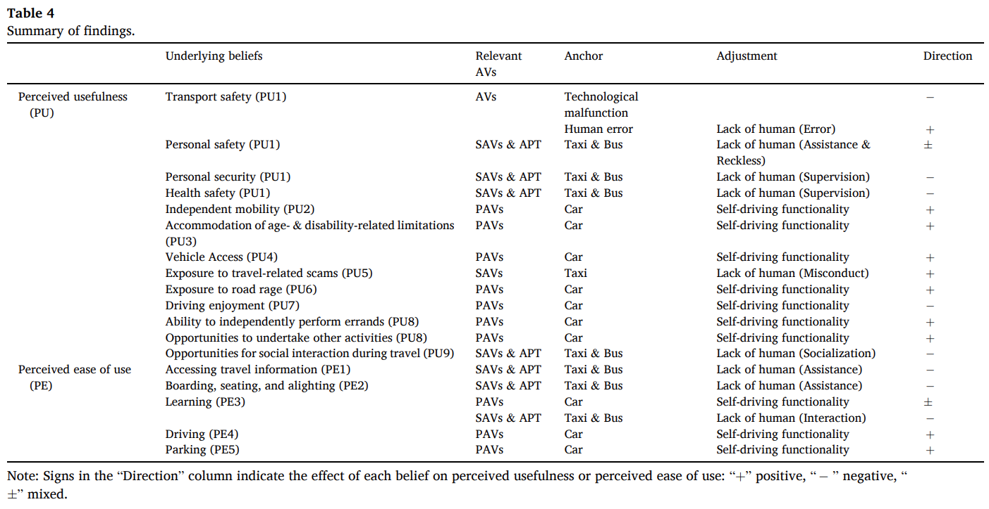
Conclusion & Recommendations

Slide 23
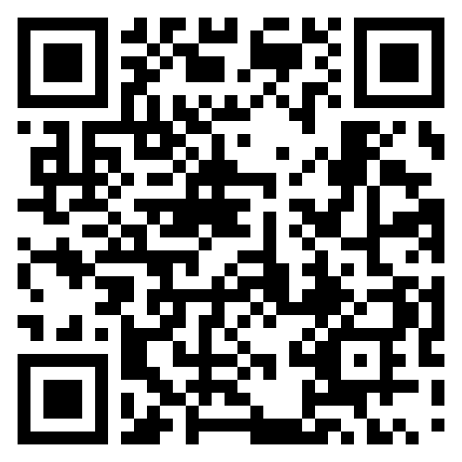
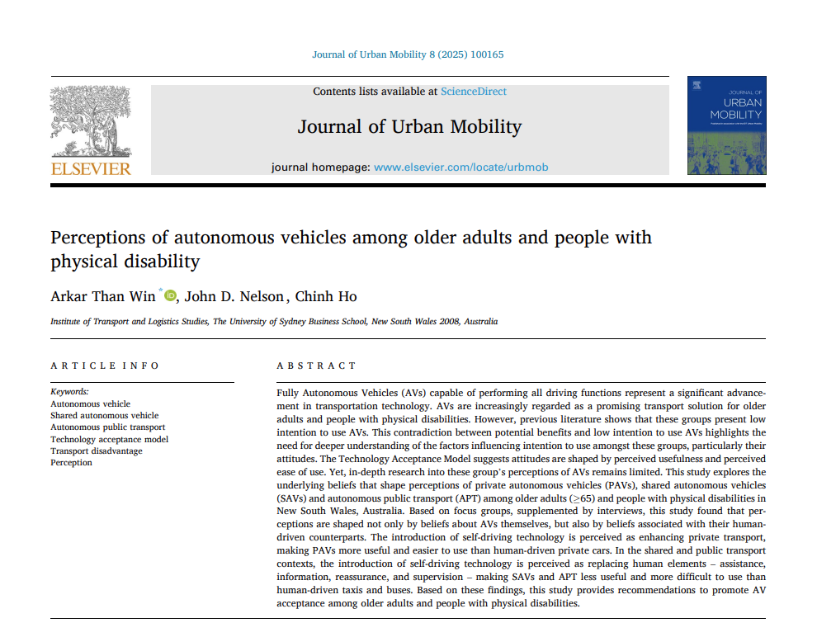
Thank you for your attention!

